Slide 1
Led Cube
8x8x8 cube using Arduino

Slide 2
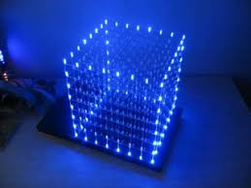
What is a led cube?
common anodes
And common cathodes can be used to individually address leds

Slide 3
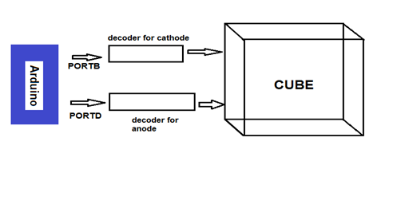
Flow of data
And usage of deMux

Slide 4
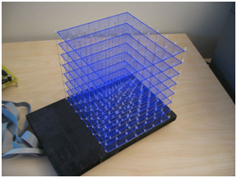
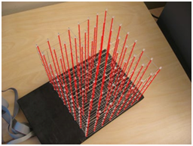
How cathode and anode are sorted

Slide 5
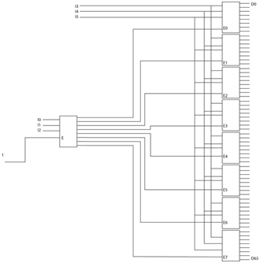
How decoder converts 6 to 63 lines

Slide 6
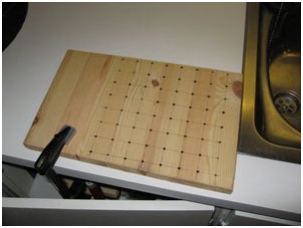
Hardware implementation

Slide 7
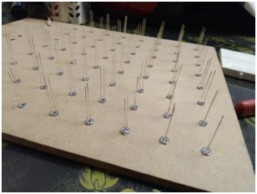
Soldering scheme
How to arrange led to make a perfect led layer

Slide 8
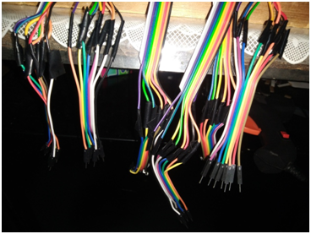
Using ribbion cables and male headers

Slide 9
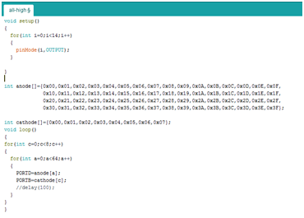
Software implementation

Slide 10
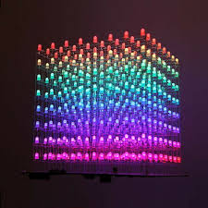
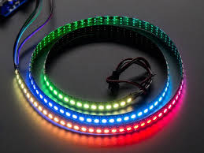
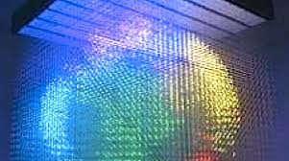
Applications
And future scope

